Slide 1
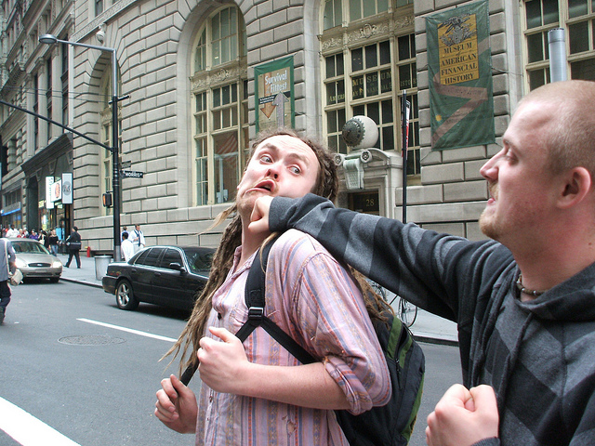

Aggression and Violence
[Professor Name]
[Class and Section Number]
Notes:
Class Recommendations: This lecture can be completed in a single class period. If you need to shorten it, you can remove some of the activities. If you want or need to lengthen the lecture, you can add in activities from the instructor manual.
Overview: During this class period, you will discuss the causes and consequences of human aggression and violence. Specifically, you will be addressing both internal and external causes of anger and the effective/ineffective techniques for reducing aggression.
Technical Note: These slides may contain simple click animation so that you can focus students’ attention on a particular question, a selection of text, or an image and not have them be distracted by reading ahead. You can either preview the sequence of animation by going through the slides in slideshow view, visiting the animations tab, or reviewing the slide notes. In the notes you will see a cue - (Click) – that corresponds to each animation.
You may also find hyperlinks to outside videos at various places in the slides. These hyperlinks are embedded in text and indicated by color and in the notes section.

Slide 2
Today’s Learning Objectives
Understand what aggression is and explain how aggression differs from violence.
Identify the internal and external causes of aggression.
Identify effective and ineffective approaches to reducing aggression.
Notes:
This slide outlines the learning objectives of the module.

Slide 3
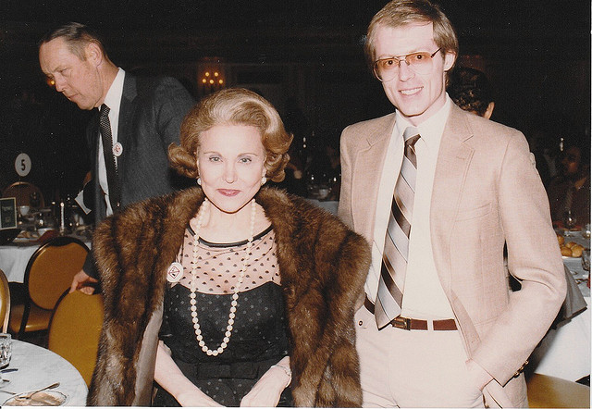
Warm Up
Discussion: Dear Abby
Listen to the following scenario
Reflect on who you think is right (and why)
Notes:
Activity: This is an activity that can take place before the students review the content in class. You can use it to see where the students are at and as a talking point throughout the rest of the lecture (especially at the end, when you can bring the lecture full circle).
(Who are Anne Landers and Dear Abbey? https://en.wikipedia.org/wiki/Ask_Ann_Landers, https://en.wikipedia.org/wiki/Dear_Abby)
Read the following excerpt to the class, then have them answer the questions (via class discussion, think-pair-share, or individual responses):
Dear Ann:
I was shocked at your advice to the mother whose three-year-old had temper tantrums. You suggested that the child be taught to kick the furniture and “get the anger out of his system.” I always thought you were a little cuckoo. Now I’m sure. My younger brother used to kick the furniture when he got mad. Mother called it, “Letting off steam.” Well—he’s 32 years old now and still kicking the furniture—what’s left of it, that is. He is also kicking his wife, the cat, the kids, and anything else that gets in his way. Last October he threw the TV set out the window when his favorite team failed to score and lost the game (the window was closed at the time). Why don’t you tell mothers that children must be taught to control their anger? This is what separates civilized human beings from savages, Dummy. — Star Witness
Dear Star:
You, like some others who wrote to criticize, ignored the most important part of my answer. I did not condone destroying furniture. I suggested that a punching bag or an old chair, speci­fically set aside for the purpose, be the object of the child’s hostility. And P.S.—the most important part of my answer went like this: “Youngsters should be taught to vent their anger against things—not people.”
This letter appeared in Ann Landers’ advice column more than 40 years ago and is perhaps as applicable today as it was then.
Discussion Questions:
Who do you think is right, Ann Landers or Star Witness?
Why?
What approach would you take?

Slide 4
Overview
Introduction
Internal Factors
External Factors
Reducing Aggression
  Catharsis
  Punishment
  Successful Interventions
Notes:
This slide shows all major topics to be covered as well as significant sub-topics (sub topics that have at least 1 slide of their own). It helps students see the “big picture” of your lecture, which makes it easier to make connections between topics.

Slide 5

Introduction
Defining Aggression:
  Behavior
  Intentional
  Undesired by victim
Aggression vs. Violence:
  All violent acts are aggressive
  But not all aggressive acts are violent
Notes:
This slide is meant to help students understand how psychologists conceptualize aggression and violence. This is especially important, as psychologists have a much more nuanced approach to aggression and violence than most laypeople.
(Click) Defining Aggression: Below are the three components of aggression.
(Click) Behavior: You can SEE it - aggression is not an internal response, such as having angry feelings or aggressive thoughts (although such internal responses can increase the likelihood of actual aggression).
(Click) Intentional: Intentional rather than accidental. For example, a dentist might intentionally give a patient a shot of Novocain (which hurts!), but the goal is to help rather than harm the patient.
(Click) Undesired: The victim wants to avoid the harm. Thus, suicide and sadomasochistic sex play would not be called aggression because the victim/participant actively seeks to be harmed.
(Click) Aggression vs. Violence: Below is the difference between aggression and violence.
(Click): All violent acts are aggressive
But not all aggressive acts are violent
Researchers define violence as aggression intended to cause extreme physical harm (e.g., injury, death). Thus, all violent acts are aggressive, but not all aggressive acts are violent. For example, screaming and swearing at another person is aggressive, but not violent.

Slide 6


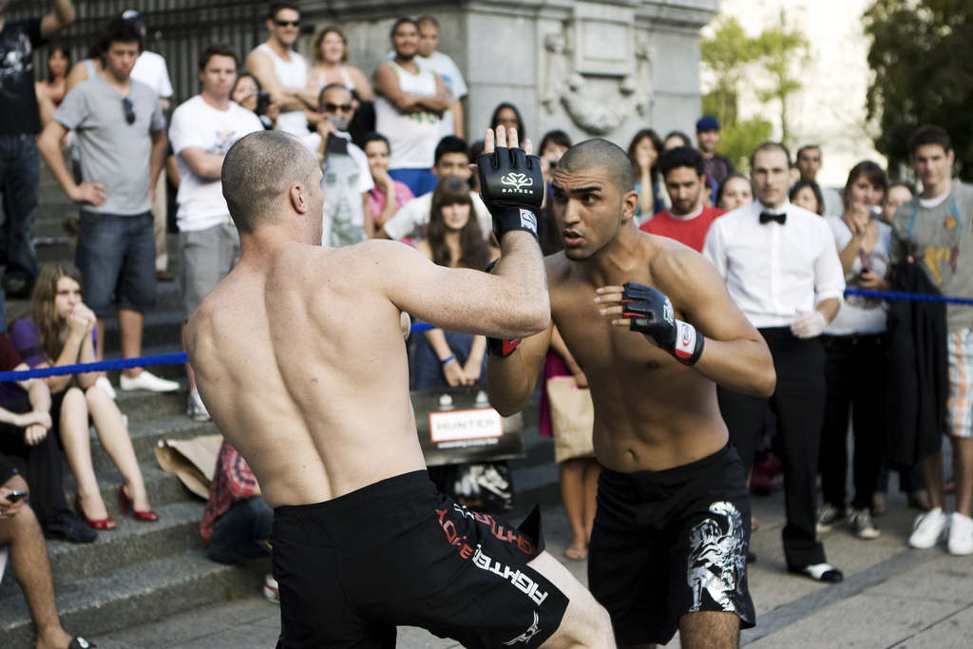
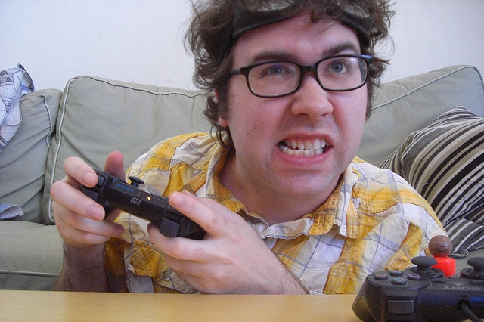
Activity: Aggression vs. Violence
Aggression vs. Violence
  Violent, Aggressive, both, or neither?
Notes:
Activity Overview:
If you have time, you can give students some real life examples. This type of pedagogy (dubbed the “testing effect”) is the most effective tool for learning. So not only are you making real world connections, you are solidifying their understanding.
(Click) Violent, Aggressive, both, or neither?: To help students apply their factual knowledge of the definitions, a series of pictures will appear that represent scenarios that are aggressive, violent, or neither. They have to decide and support their answer (this can be done as a class discussion, i-clicker questions, or as a mini-writing activity).
(Click) Picture of angry gamer: You are playing a video game and yell at another player or your team mates
(Click) Picture of boxing match: Two boxers in an organized/sanctioned street fight.
(Click) Picture of a soldier: A soldier shoots an enemy at the front line
(Click) Picture of woman screaming: A woman yells/berates her significant other for not doing his/her chores.

Slide 7
Overview
Introduction
Internal Factors
External Factors
Reducing Aggression
  Catharsis
  Punishment
  Successful Interventions
Notes:
Mid-lecture Overview

Slide 8

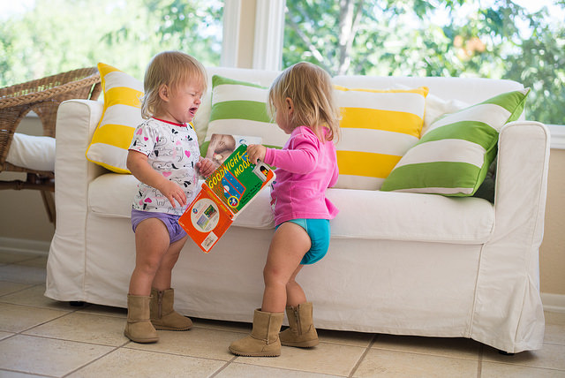
Internal Factors
Age
Gender
Why do you think
gender differences
in aggression exist?
Notes:
This slide is meant to help students understand the internal factors that best predict aggression.
You can begin by asking students what demographic factors they think influence aggression. For example – start by asking them about trends with age – do we get more or less aggressive as we age? Which age groups tend to be more aggressive? Why do you think that is?
(Click) Age: Surprisingly, toddlers are the most aggressive (though not the most violent). Although most people become less aggressive over time, some individuals do get more aggressive around late adolescence and early adulthood.
(Click) Gender: The discussion of aggression and gender is often very interesting to students (and people in general). You can talk about the stereotypes of gender and aggression and then follow up with what the research says: At all ages, males tend to be more physically aggressive than females. However, females are much more likely than males to engage in relational aggression (defined as intentionally harming another person’s social relationships, feelings of acceptance, or inclusion within a group; Crick & Grotpeter, 1995). Examples of relational aggression include gossiping, spreading rumors, withdrawing affection to get what you want, excluding someone from your circle of friends, and giving someone the “silent treatment.”
Picture of Gender: You can continue your talk about different kinds of aggression and how it relates to gender. For example, females do use physical aggression, especially when they are provoked by other females (Collins, Quigley, & Leonard, 2007). Among heterosexual partners, women are actually slightly more likely than men to use physical aggression (Archer, 2000). However, when men do use physical aggression, they are more likely than women to cause serious injuries and even death to their partners. When people are strongly provoked, gender differences in aggression shrink (Bettencourt & Miller, 1996).
(Click) Discussion Point: Why do you think gender differences in aggression exist?
If you wanted to include some (American) pop-culture references, you could talk about the movie Mean Girls and how it nicely illustrates relational aggression (here is a link to a scene where the characters use three way calling to inflict relational harm on one another: https://www.youtube.com/watch?v=yWryEInMeTA).
References:
Crick, N. R., & Grotpeter, J. K. (1995). Relational aggression, gender, and social‐psychological adjustment. Child Development, 66(3), 710-722.
Lorraine Collins, R., Quigley, B., & Leonard, K. E. (2007). Women's physical aggression in bars: an event‐based examination of precipitants and predictors of severity. Aggressive Behavior, 33(4), 304-313.
Archer, J. (2000). Sex differences in aggression between heterosexual partners: a meta-analytic review. Psychological Bulletin, 126(5), 651.
Bettencourt, B., & Miller, N. (1996). Gender differences in aggression as a function of provocation: a meta-analysis. Psychological Bulletin, 119(3), 422.

Slide 9

Internal Factors
Imagine…
Personality Traits
  The Dark Triad
Hostile Cognitive Biases
  Hostile attribution bias
  Hostile perception bias
  Hostile expectation bias
Notes:
This slide is meant to help students move beyond basic demographic information to some of the specific individual differences that predict someone’s likelihood for aggression.
Imagine…:
You can begin by giving students a basic scenario (e.g.: Imagine you are walking along some downtown shops. As you walk along the sidewalk, you see a stranger heading toward you. You move slightly to the side to avoid running into them, but the stranger sharply bumps into you, even though you left him/her plenty of room to get around you. How do you react?).
Give some time for the students to think about their response to this situation. Once you have given them the chance to reflect, you can solicit responses from the class. You can then use this scenario as a springboard for explaining how different people would react (some might just shrug their shoulders and move on, some might say something/verbally confront the stranger, some might physically push back, etc.). This gives you a platform for introducing the formal concepts behind these reactions.
(Click) Personality Traits: Aggressiveness is almost as stable as intelligence over time (Olweus, 1979).
The dark triad: The components of the “Dark Triad of Personality”—narcissism, psychopathy, and Machiavellianism—are also related to aggression (Paulhus & Williams, 2002).
(Click) Hostile Cognitive Biases: One key to keeping aggression in check is to give people the benefit of the doubt. Some people, however, do just the opposite. There are three hostile cognitive biases.
(Click) Hostile Attribution Bias: tendency to perceive ambiguous actions by others as hostile actions (Dodge, 1980). For example, if a person bumps into you, a hostile attribution would be that the person did it on purpose and wants to hurt you.
(Click) Hostile Perception Bias: tendency to perceive social interactions in general, as being aggressive (Dill, Anderson, Anderson & Deuser, 1997). For example, if you see two people talking in an animated fashion, a hostile perception would be that they are fighting with each other.
(Click) Hostile Expectation Bias: tendency to expect others to react to potential conflicts with aggression (Dill et al., 1997). For example, if you bump into another person, a hostile expectation would be that the person will assume that you did it on purpose and will attack you in return.
References:
Olweus, D. (1979). Stability of aggressive reaction patterns in males: a review. Psychological Bulletin, 86(4), 852-875.
Paulhus, D. L., & Williams, K. M. (2002). The dark triad of personality: Narcissism, Machiavellianism, and psychopathy. Journal of Research in Personality, 36(6), 556-563.
Dodge, K. A. (1980). Social cognition and children's aggressive behavior. Child Development, 51(1), 162-170.
Dill, K. E., Anderson, C. A., Anderson, K. B., & Deuser, W. E. (1997). Effects of aggressive personality on social expectations and social perceptions. Journal of Research in Personality, 31(2), 272-292.

Slide 10
Overview
Introduction
Internal Factors
External Factors
Reducing Aggression
  Catharsis
  Punishment
  Successful Interventions
Notes:
Mid-lecture Overview

Slide 11
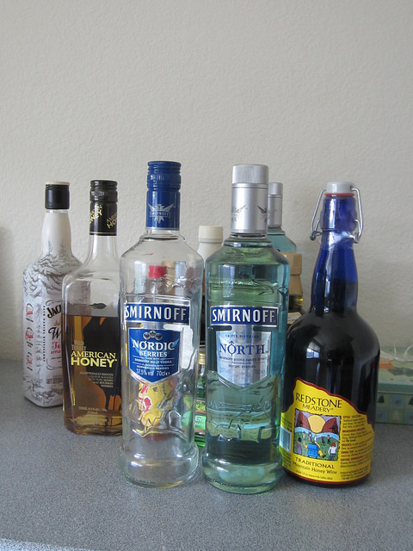

External Factors
Frustration and Other Unpleasant Events
Alcohol
Are there any times where
aggression or violence
are necessary (e.g., war)?
Notes:
The purpose of this slide is to show students that aggression is not just a manifestation of how a person IS, but also how their environment influences the likelihood of aggression.
(Click) Frustration and other Unpleasant Events: Unpleasant events such as frustrations, provocations, social rejections, hot temperatures, loud noises, and crowding can all cause aggression.
(Click) Picture of Shoveling Snow: An example scenario of frustration
For example, you wake up on-time on the day of your final for this class. However, when you get outside, you realized that it snowed the night before. Before you can head to school, you have to shovel your driveway (otherwise you will get stuck). Even though it took 30 minutes, you are still on time, but you have to leave NOW in order to get to your final on time. You get about a mile away from your house, only to realize you left your backpack at home. You turn around to get it and realize that you are definitely going to be late to your exam. Finally, you get to campus and pull into the parking lot. In your single good piece of luck for the day, there is ONE parking spot left! As you turn on your signal to turn into the spot, another car quickly approaches and steals your spot! By now, you’ve had enough – you had to shovel out your driveway, go back home for your backpack, lose your parking spot, and be late for your final. Frustrated by the days events, you curse at the other driver and decide to leave a note on their car.
(Click) Alcohol: One way that alcohol leads to aggression is by disrupting the cognitive executive functions that help us organize, plan, achieve goals, and inhibit inappropriate behaviors (a pharmacological theory). Another way that alcohol can lead to aggression is through our social expectations regarding alcohol and aggression (an expectancy theory).
(Click) Discussion Point: Are there any times where aggression or violence are necessary (e.g., war)?

Slide 12
Overview
Introduction
Internal Factors
External Factors
Reducing Aggression
  Catharsis
  Punishment
  Successful Interventions
Notes:
Mid-lecture Overview

Slide 13


Reducing Aggression
Catharsis
Punishment
So…if those don’t work, what does?!
Notes:
Up until this point, we have talked about what aggression is and what predicts it. Here, we move into how to deal/cope with it.
(Click) Catharsis: According to catharsis theory, acting aggressively or viewing aggression purges angry feelings and aggressive impulses into harmless channels. Example: punching a pillow (or as the picture indicates, a pillow fight). Unfortunately, research does not support this approach. Instead, it is better to address the physiological and cognitive components of anger.
(Click) Punishment: Punishment is most effective when it is: (a) intense, (b) prompt, (c) applied consistently and with certainty, (d) perceived as justified, and (e) possible to replace the undesired punishable behavior with a desired alternative behavior. However, research has shown that punishment, even when done correctly, is not necessarily effective.
(Click) Discussion: If those don’t work, what does?: Here, you can have the students brainstorm idea they think would work in addressing issues of aggression.

Slide 14
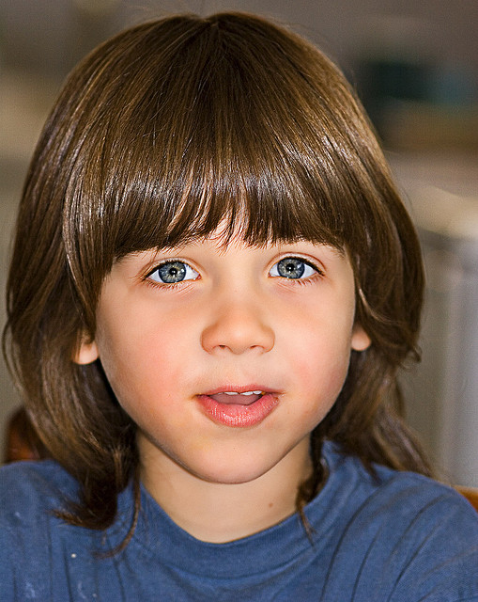
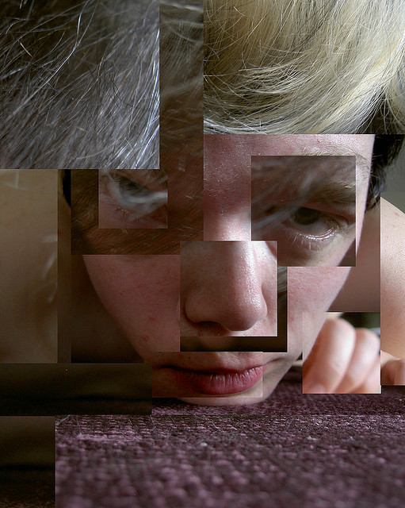

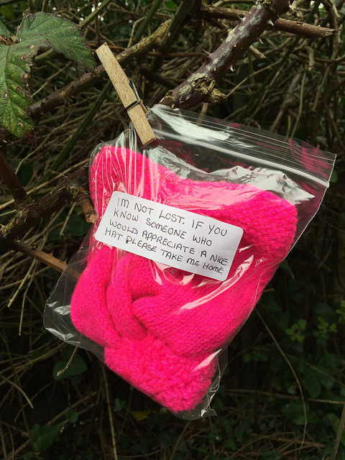
Reducing Aggression
Successful Interventions
  Bodily States
  Mental Meanings
  Multifaceted Targets
  Early Development
How would you deal with someone who is demonstrating hostile cognitive biases?
Notes:
This slide explains how we can deal/cope with feelings of aggression.
Successful Interventions: If venting and punishing anger doesn’t get rid of it, what does?
(Click) Bodily States: All emotions, including anger, consist of bodily states (e.g., arousal). Anger can be reduced by getting rid of the arousal state, such as by relaxing, listening to calming music, or counting to 10 before responding.
Picture: Relaxing: Discuss the importance of taking time to reduce physiological manifestations of anger (heart rate, breathing, etc.) back to baseline. As suggested above, you can give yourself a timeout for breathing, counting to 10, etc. The point is to get those bodily states under control!
(Click) Mental Meanings: Anger also consists of mental meanings. Mental tactics can also reduce anger, such as by reframing the situation or by distracting oneself and turning one’s attention to more pleasant topics. Incompatible behaviors can also help get rid of anger. For example, petting a puppy, watching a comedy, kissing your lover, or helping someone in need, because those acts are incompatible with anger and, therefore, they make the angry state impossible to sustain (e.g., Baron, 1976). Viewing the provocative situation from a more distant perspective, such as that of a fly on the wall, also helps (Mischkowski, Kross, & Bushman, 2012).
Picture: Random Act of Kindness: As suggested above, one way to reduce feelings of anger is to engage in positive behaviors that change your state of mind. In this example, the idea is to do something positive for someone else, even if it is done anonymously. The point is to change what you are doing so it changes what you are thinking/feeling.
(Click) Multifaceted Targets: Successful interventions target as many causes of aggression as possible and attempt to tackle them collectively.
Picture: Face Mosaic: This image depicts a person with a fractured mosaic face to illustrate the point that there might be multiple causes of aggression within the same individual.
(Click) Early Development: Aggression problems are best treated in early development.
Picture: Child: This image depicts a child in an early stage of development when aggression interventions are the most beneficial.
Discussion Point: How would you deal with someone who is demonstrating hostile cognitive biases?
References:
Baron, R. A. (1976). The Reduction of Human Aggression: A Field Study of the Influence of Incompatible Reactions1. Journal of Applied Social Psychology, 6(3), 260-274.
Mischkowski, D., Kross, E., & Bushman, B. J. (2012). Flies on the wall are less aggressive: Self-distancing “in the heat of the moment” reduces aggressive thoughts, angry feelings and aggressive behavior. Journal of Experimental Social Psychology, 48(5), 1187-1191.

Slide 15

Activity: Create an
Intervention
Get into groups
Answer the question, “How can we reduce bullying in middle schools?”
Design an intervention aimed at reducing bullying? Come up with at least 3 suggestions
Notes:
Overview:
You can do this as a class discussion or as a small activity (small group activity is suggested, so each student has more input). The students are to create an intervention, designed for a middle school; one that addresses the problem of peer bullying.
This can take anywhere from 5 to 30 minutes (or more), depending on how thorough you want their responses to be. A quick brainstorming session to apply the ideas should only take about 5-10 minutes. If you want in-depth and very specific recommendations for reducing bullying, 30 minutes is more appropriate.
(Click) Directions:
Get into groups
Answer the question, “How can we reduce bullying (aggression and violence) in middle schools?”
Design an intervention aimed at reducing bullying and come up with at least three suggestions
If you want more structure, you can point out some issues for their consideration (see next slide). A few examples are below (and pasted into the following slide):
How will you PREVENT bullying?
If bullying occurs, how will you deal with it?
Does the type of aggression matter?
What about online bullying or bullying outside of school? How will that be handled?

Slide 16

Activity: Create an
Intervention
Considerations
  How will you PREVENT bullying?
  If bullying occurs, how will you deal with it?
  Does the type of aggression matter?
  What about online bullying or bullying outside of school? How will that be handled?
Notes:
If you want more structure, you can point out some issues for their consideration. A few examples are below (and pasted into the slide):
(Click):
Considerations
How will you PREVENT bullying?
If bullying occurs, how will you deal with it?
Does the type of aggression matter?
What about online bullying or bullying outside of school? How will that be handled?

Slide 17

Wrap Up Discussion
Using what you know about violence and aggression, how can school systems prevent and deal with bullying?
Why do you think gender differences in aggression exist?
Are there any times where aggression or violence are necessary (e.g., war)?
The book provided evidence that, on the whole, violence is on the decline. Why do you think that is?
Notes:
This slide presents the wrap up discussion for the topic of aggression and violence.
1. Using what you know about violence and aggression, how can school systems prevent and deal with bullying?
• The purpose of this discussion question is to get students applying the information they have learned. You want them to be able to not only be able to remember the factual information presented in class, but be able to think critically about how this information is applied. Further, it reinforces the importance of using scientific findings to positively impact their environment (as opposed to gut feelings regarding bullying).
2. Why do you think gender differences in aggression exist?
• This should be an interesting discussion! One goal of this discussion question is not only reiterate points made in the chapter, but to give students the opportunity for students to make connections across modules/units. In a best-case scenario, students can bring up information from the nature/nurture part of the course.
3. Are there any times where aggression or violence are necessary (e.g., war)?
• This, of course, is going to be a value laden discussion question. One of the goals of asking a question like this is to have students support their opinion based on psychological research and theory.
4. The book provided evidence that, on the whole, violence is on the decline. Why do you think that is? Further, if violence is on the decline, why are there so many news stories about it? What is it about aggression and violence that captivates people?
• This question has so much potential for an interesting discussion! One goal would be to have students make connections to other areas of class (e.g., the spread of negative vs. positive emotions, confirmation bias, anecdotal vs. science-based data, etc.).

Slide 18

CAT: One-Minute Paper
What was the most important thing you learned during this class?
What important question remains unanswered?
Notes:
Classroom Assessment Technique (CAT): One-Minute Paper
If you are presenting the information on one class day, you might end the material about here. End your class time with a one-minute paper.
The Minute Paper tests how students are gaining knowledge, or not. The instructor ends class by asking students to write a brief response to the following questions: “What was the most important thing you learned during this class?” and “What important question remains unanswered?”
Have students briefly answer these questions in writing and turn them in. After class, assess students’ responses. At the beginning of the next class, go over any misunderstandings or relevant questions.
If you do not conclude with this Classroom Assessment Technique (CAT), it would helpful to use another CAT. It could be in the form of a:
Muddy point
One-minute paper
Background knowledge
What’s the Principle?
Defining features Matrix:
For more information on CATs click here: http://cft.vanderbilt.edu/guides-sub-pages/cats/

Slide 19
Photo Attribution
Slide 1 | Photo Credit: Punching the Hippie robgsummers https://www.flickr.com/photos/robgsummers/5499639470 https://creativecommons.org/licenses/by-sa/2.0/
Slide 3 | Photo Credit: Ann Landers and me Alan Light https://www.flickr.com/photos/42274165@N00/2401376017/ https://creativecommons.org/licenses/by/2.0/
Slide 5 | Photo Credit: Anger 2 Aphrodite https://www.flickr.com/photos/57054262@N00/46341539/ https://creativecommons.org/licenses/by-nc-nd/2.0/
Slide 6 | Photo Credit: Video Games Radly J Phoenix https://www.flickr.com/photos/radjose/4460564381 https://creativecommons.org/licenses/by-sa/2.0/ Photo Credit: UFC Flash Fight @ Vancouver Art Gallery Todd Smith https://www.flickr.com/photos/tsdesign/3926283343/ https://creativecommons.org/licenses/by-nc-nd/2.0/ Photo Credit: 150113-M-PK171-755 U.S. Department of Defense Current Photos https://www.flickr.com/photos/39955793@N07/16966020146/ https://creativecommons.org/licenses/by-nc-nd/2.0/ Photo Credit: shout it out. Katrina Cole https://www.flickr.com/photos/iamkat/2916813731/ https://creativecommons.org/licenses/by-nc/2.0/
Slide 8 | Photo Credit: Twins Fighting Over Books Donnie Ray Jones https://www.flickr.com/photos/donnieray/14835028880/ https://creativecommons.org/licenses/by/2.0/ Photo Credit: man-couple-people-woman Gratisphotography.com http://www.pexels.com/photo/man-couple-people-woman-343/ https://creativecommons.org/publicdomain/zero/1.0/
Slide 9 | Photo Credit: Downtown Portland Amber Case https://www.flickr.com/photos/28980639@N02/3286661789/ https://creativecommons.org/licenses/by-nc/2.0/
Slide 11 | Photo Credit: brooklyn blizzard HI TRICIA! 王 圣 捷 https://www.flickr.com/photos/53991912@N00/4206771418/ https://creativecommons.org/licenses/by-nc-sa/2.0/ Photo Credit: Smirnoff Nelo Hotsuma https://www.flickr.com/photos/63122283@N06/14111535634/ https://creativecommons.org/licenses/by/2.0/
Slide 13 | Photo Credit: Pillow Attack The Smokey https://www.flickr.com/photos/intothecloud/496629793/ https://creativecommons.org/licenses/by-nc-nd/2.0/ Photo Credit: Prison cell with bed inside Alcatraz main building san francisco California Tim (Timothy) Pearce https://www.flickr.com/photos/timpearcelosgatos/3557791151/ https://creativecommons.org/licenses/by/2.0/
Notes:
Photo Attribution Slide

Slide 20
Photo Attribution
Slide 14 | Photo Credit: Rocking Out Elyse https://www.flickr.com/photos/8222884@N04/3289602710/ https://creativecommons.org/licenses/by-nd/2.0/ Photo Credit: Random Act of Kindness Jonathan Rolande https://www.flickr.com/photos/jonathanrolande/16946837997/ https://creativecommons.org/licenses/by/2.0/ Photo Credit: 060527collage Dan4th Nicholas https://www.flickr.com/photos/43264265@N00/154175586/ https://creativecommons.org/licenses/by/2.0/ Photo Credit: Elijah Randen Pederson https://www.flickr.com/photos/48394718@N00/386016511/ https://creativecommons.org/licenses/by/2.0/
Slide 15 | Photo Credit: 140:365 – Left Out charamelody https://www.flickr.com/photos/charamelody/4757913318 https://creativecommons.org/licenses/by-nc/2.0/
Slide 16 | Photo Credit: Bullying Jedidja https://pixabay.com/en/bullying-hands-face-curl-up-her-679274/ https://creativecommons.org/publicdomain/zero/1.0/
Slide 17 | Photo Credit: Questions1 Grisel D´An https://www.flickr.com/photos/128454566@N06/15893429463 https://creativecommons.org/licenses/by-nc/2.0/
Slide 18 | Photo Credit: Illustrated silhouette of a black cat nehtaeh79 http://www.freestockphotos.biz/stockphoto/16624 http://creativecommons.org/publicdomain/zero/1.0/
Notes:
Photo Attribution Slide

